Slide 1
Writing Fast MATLAB Code
Jia-Bin Huang
University of Illinois, Urbana-Champaign
www.jiabinhuang.com
jbhuang1@Illinois.edu

Slide 2
Resources
Techniques for Improving Performance by Mathwork
Writing Fast Matlab Code by Pascal Getreuer
Guidelines for writing clean and fast code in MATLAB by Nico Schlömer
http://www.slideshare.net/UNISTSupercomputingCenter/speeding-upmatlabapplications
http://www.matlabtips.com/

Slide 3
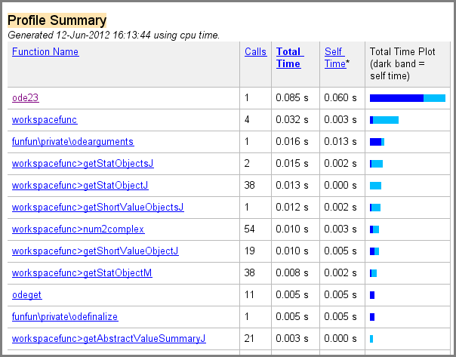
Using the Profiler
Helps uncover performance problems
Timing functions:
tic, toc
The following timings were measured on - CPU i5 1.7 GHz - 4 GB RAM
http://www.mathworks.com/help/matlab/ref/profile.html

Slide 4
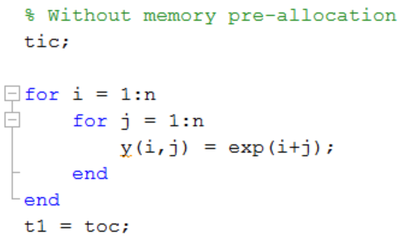
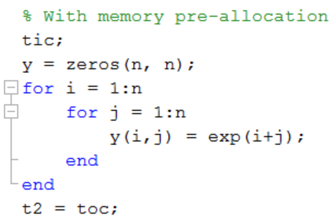
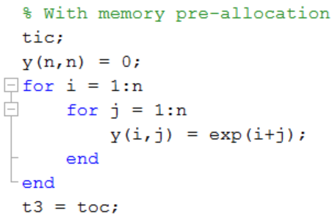
Pre-allocation Memory
>> n = 1000;
3.3071 s
2.5148 s
2.1804 s

Slide 5
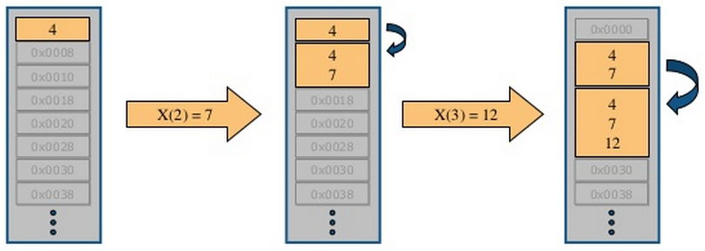
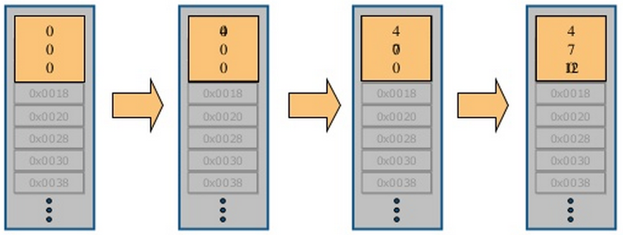
Reducing Memory Operations
>> x = 4;
>> x(2) = 7;
>> x(3) = 12;
>> x = zeros(3,1);
>> x = 4;
>> x(2) = 7;
>> x(3) = 12;
Notes:
Repeatedly expanding the size of an array over time, (for example, adding more elements to it each time through a programming loop), can adversely affect the performance of your program. This is because
1) MATLAB has to spend time allocating more memory each time you increase the size of the array.
2) This newly allocated memory is likely to be noncontiguous, thus slowing down any operations that MATLAB needs to perform on the array.

Slide 6
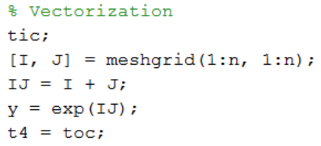
Vectorization
http://www.mathworks.com/help/matlab/matlab_prog/vectorization.html
2.1804 s
0.0157 s
139x faster!

Slide 7
Using Vectorization
Appearance
more like the mathematical expressions, easier to understand.
Less Error Prone
Vectorized code is often shorter.
Fewer opportunities to introduce programming errors.
Performance:
Often runs much faster than the corresponding code containing loops.
See http://www.mathworks.com/help/matlab/matlab_prog/vectorization.html

Slide 8
Binary Singleton Expansion Function
Make each column in A zero mean
>> n1 = 5000;
>> n2 = 10000;
>> A = randn(n1, n2);
See http://blogs.mathworks.com/loren/2008/08/04/comparing-repmat-and-bsxfun-performance/
Why bsxfun is faster than repmat?
bsxfun handles replication of the array implicitly, thus avoid memory allocation
Bsxfun supports multi-thread
0.2994 s
0.2251 s

Slide 9
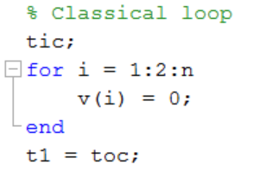
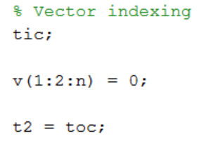
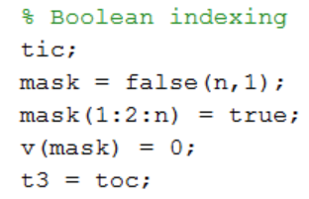
Loop, Vector and Boolean Indexing
Make odd entries in vector v zero
n = 1e6;
See http://www.mathworks.com/help/matlab/learn_matlab/array-indexing.html
See Fast manipulation of multi-dimensional arrays in Matlab by Kevin Murphy
0.3772 s
0.0081 s
0.0130 s

Slide 10
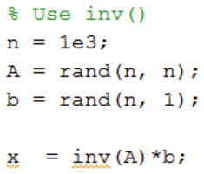
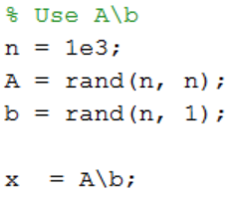
Solving Linear Equation System
0.1620 s
0.0467 s

Slide 11
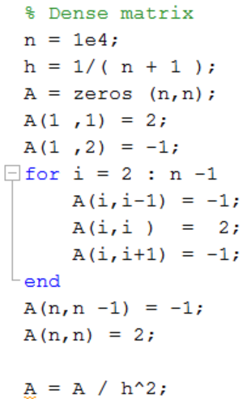
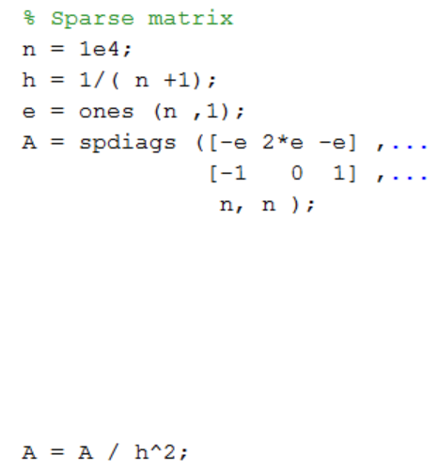
Dense and Sparse Matrices
Dense: 16.1332 s
Sparse: 0.0040 s
More than 4000x faster!
Useful functions: sparse(), spdiags(), speye(), kron().
0.6424 s
0.1157 s

Slide 12
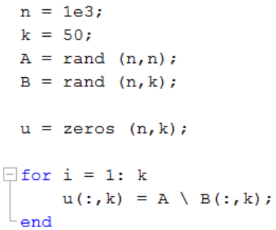
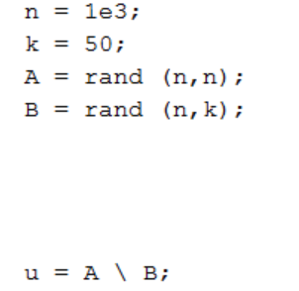
Repeated solution of an equation system with the same matrix
3.0897 s
0.0739 s

Slide 13
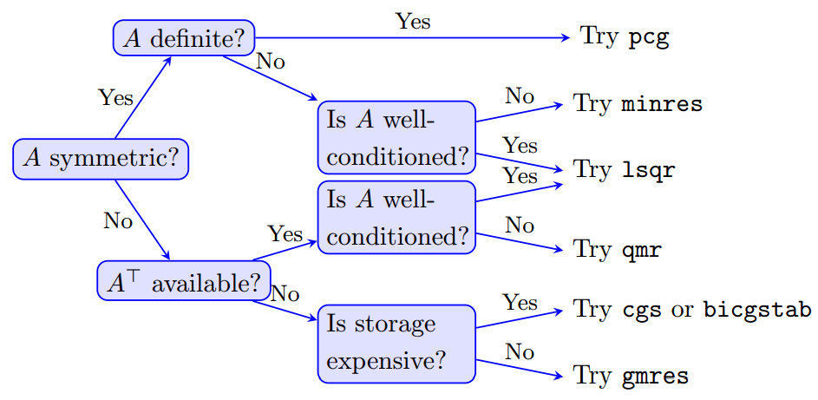
Iterative Methods for Larger Problems
Iterative solvers in MATLAB:
bicg, bicgstab, cgs, gmres, lsqr, minres, pcg, symmlq, qmr
[x,flag,relres,iter,resvec] = method(A,b,tol,maxit,M1,M2,x0)
source: Writing Fast Matlab Code by Pascal Getreuer

Slide 14
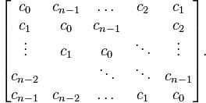
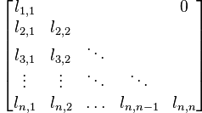
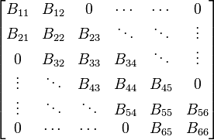
Solving Ax = b when A is a Special Matrix
Circulant matrices
Matrices corresponding to cyclic convolution Ax = conv(h, x) are diagonalized in the Fourier domain >> x = ifft( fft(b) ./ fft(h) );
Triangular and banded
Efficiently solved by sparse LU factorization
>> [L,U] = lu(sparse(A));
>> x = U\(L\b);
Poisson problems
See http://www.cs.berkeley.edu/~demmel/cs267/lecture25/lecture25.html

Slide 15
In-place Computation
>> x=randn(1000,1000,50);
0.1938 s
0.0560 s

Slide 16
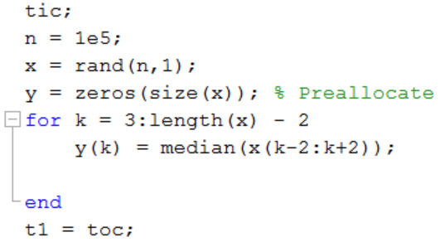
Inlining Simple Functions
1.1942 s
0.3065 s
y = medfilt1(x,5);
0.2082 s
functions are worth inlining: - conv, cross, fft2, fliplr, flipud, ifft, ifft2, ifftn, ind2sub, ismember, linspace, logspace, mean, median, meshgrid, poly, polyval, repmat, roots, rot90, setdiff, setxor, sortrows, std, sub2ind, union, unique, var

Slide 17
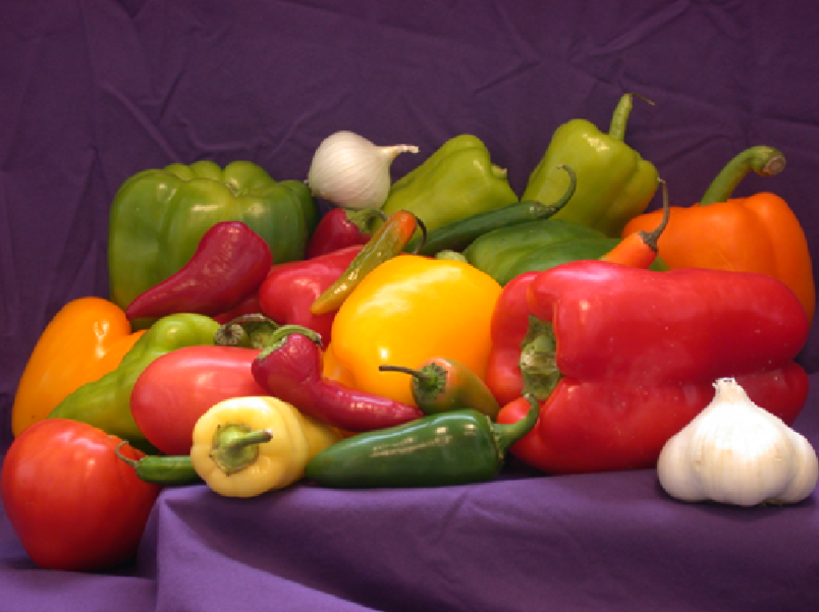
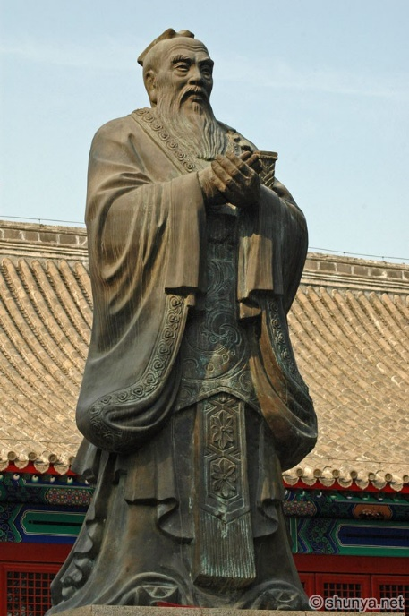
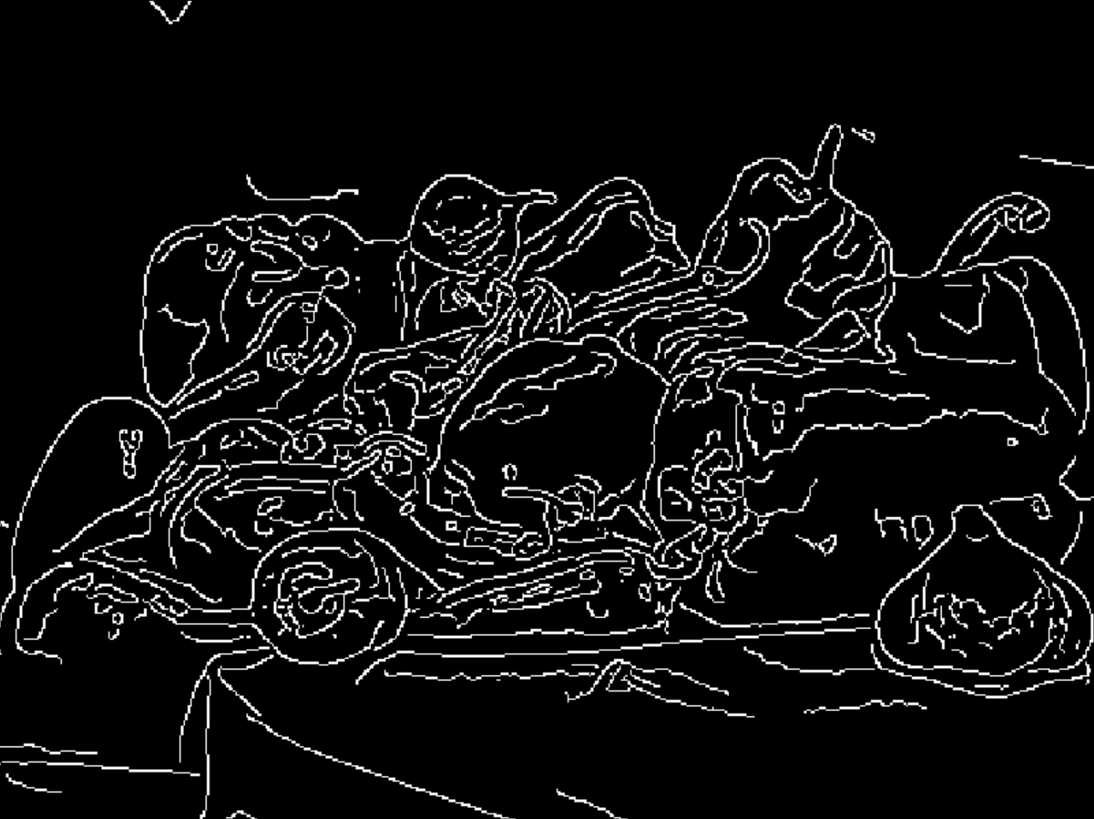
Using the Right Type of Data
“Do not use a cannon to kill a mosquito.”
double image: 0.5295 s
Confucius
uint8 image: 0.1676 s

Slide 18
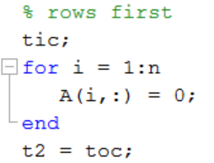
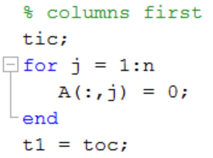
Matlab Organize its Arrays as Column-Major
Assign A to zero row-by-row or column-by-column
>> n = 1e4;
>> A = randn(n, n);
2.1740 s
0.1041 s

Slide 19
Column-Major Memory Storage
>> x = magic(3)
x =
8 1 6
3 5 7
4 9 2
% Access one column
>> y = x(:, 1);
% Access one row
>> y = x(1, :);

Slide 20
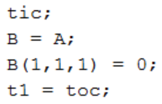
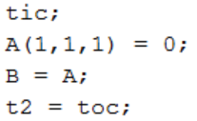
Copy-on-Write (COW)
>> n = 500;
>> A = randn(n,n,n);
0.4794 s
0.0940 s

Slide 21
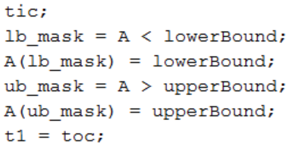
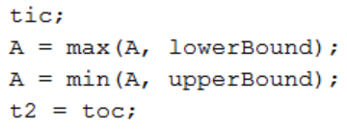
Clip values
>> n = 2000;
>> lowerBound = 0;
>> upperBound = 1;
>> A = randn(n,n);
0.1285 s
0.0121 s

Slide 22
Moving Average Filter
Compute an N-sample moving average of x
>> n = 1e7;
>> N = 1000;
>> x = randn(n,1);
3.2285 s
0.3847 s

Slide 23
Find the min/max of a matrix or N-d array
>> n = 500;
>> A = randn(n,n,n);
0.5465 s
0.1938 s

Slide 24
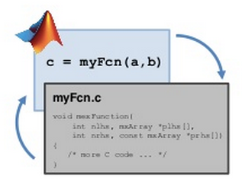
Acceleration using MEX (Matlab Executable)
Call your C, C++, or Fortran codes from the MATLAB
Speed up specific subroutines
See http://www.mathworks.com/help/matlab/matlab_external/introducing-mex-files.html

Slide 25
MATLAB Coder
MATLAB Coder™ generates standalone C and C++ code from MATLAB® code
See video examples in http://www.mathworks.com/products/matlab-coder/videos.html
See http://www.mathworks.com/products/matlab-coder/

Slide 26
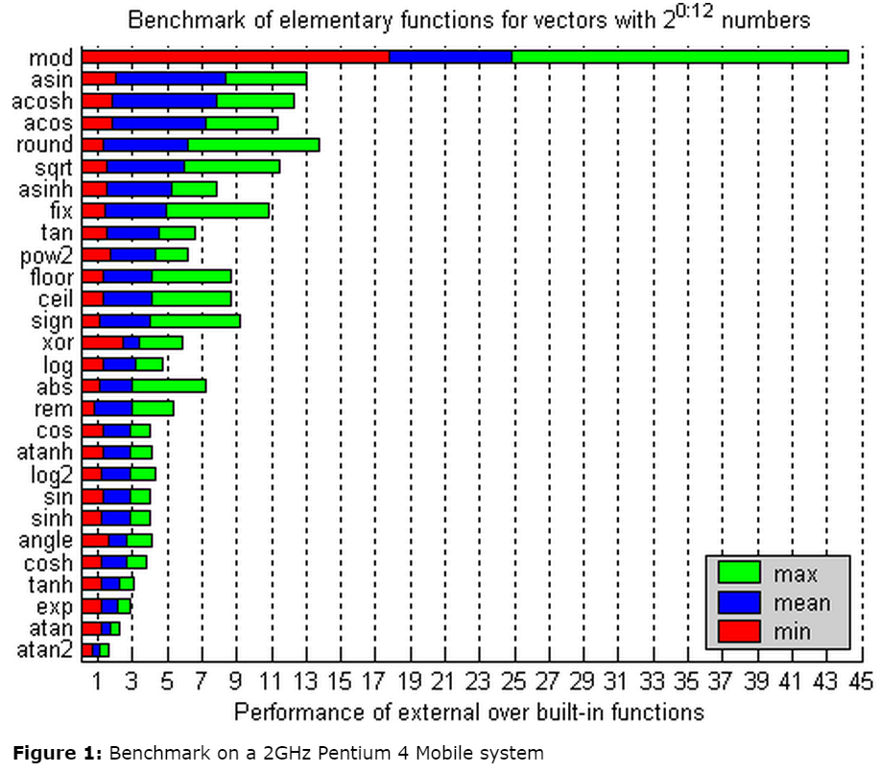
DoubleClass
http://documents.epfl.ch/users/l/le/leuteneg/www/MATLABToolbox/DoubleClass.html

Slide 27
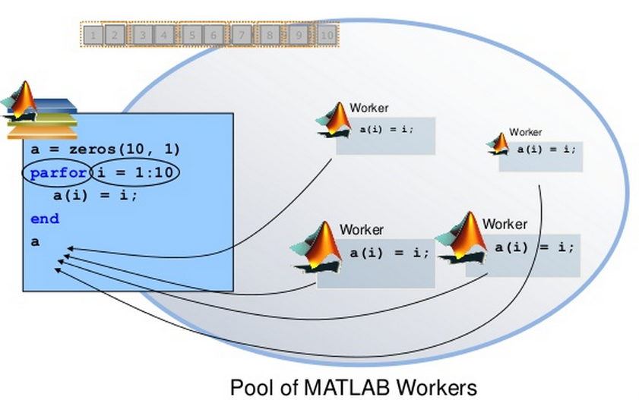
parfor for parallel processing
Requirements
Task independent
Order independent
See http://www.mathworks.com/products/parallel-computing/

Slide 28
Parallel Processing in Matlab
MatlabMPI
multicore
pMatlab: Parallel Matlab Toolbox
Parallel Computing Toolbox (Mathworks)
Distributed Computing Server (Mathworks)
MATLAB plug-in for CUDA (CUDA is a library that used an nVidia board)
Source: http://www-h.eng.cam.ac.uk/help/tpl/programs/Matlab/faster_scripts.html

Slide 29
Resources for your final project
Awesome computer vision by Jia-Bin Huang
A curated list of computer vision resources
VLFeat
features extraction and matching, segmentation, clustering
Piotr's Computer Vision Matlab Toolbox
Filters, channels, detectors, image/video manipulation
OpenCV (MexOpenCV by Kota Yamaguchi)
General purpose computer vision library

