Slide 1
Council on Teacher Education

Slide 2
Licensure Staff for EPOL Programs
Suzanne Lee, Associate Director/Licensure Officer
SuzanneL@illinois.edu
Robin Craig, Licensure Officer
rcraig@illinois.edu
info@cote.Illinois.edu
College of Education Building
1310 South 6th Street, Room 130
Phone: 217-333-2804

Slide 3
License versus Degree
Licensure and internship courses are a subset of the full Ed.D. program. Candidates can complete the superintendent endorsement before the full doctoral program has been finished, i.e., you can receive your supt endorsement before you complete your doctoral degree.
EPOL 530
EPOL 541
EPOL 544
EPOL 546
EPOL 547
EPOL 548
EPOL 549
ERAM 556
EPOL 597 (2 semesters)

Slide 4
CoTE monitors . . .
Grade Point Average (3.0)
Licensure program course grades lower than a C- (Incomplete → F by rule)
Licensure requirements regarding work experience/internship assignment
Verification of work experience
Mentor qualification form
Content Test (ILTS 255; study materials available inside CoTE portal)
Administrator Academy (#2000; principal evaluation)
Safety Training (after 7/1/2024)

Slide 5
Internship
Clinical Experience Administration, EPOL 597, two semesters
Must be conducted at one (or more) public school districts “so as to enable the candidate to be exposed to and to participate in a variety of educational leadership situations in settings that represent diverse economic and cultural conditions and involve interaction with various members of the school community (e.g., parents, school board members, local school councils or other governing councils, community partners)” (Part 33 rules)
Must be in a district that has a placement contract with UIUC. If there is no contract currently in place, it can take several months to execute. If you plan to complete internship during the 2024-25 school year, please complete this short survey now and submit during class.
https://surveys.illinois.edu/sec/180355533

Slide 6
Supt Internship Mentor Qualifications
You will not be able to register for your first term of EPOL 597 until the mentor qualification form and recommendation letter/eval has been turned in to Gabrielle and approved by EPOL faculty
Mentor criteria:
Valid & current PEL with a supt endorsement.
At least two years of full-time successful experience as a superintendent, as evidenced by relevant data*.
Exception to this rule:
A first-year superintendent may serve as internship supervisor if the individual was hired after the candidate started the internship in the respective school district.
Formal evaluation or letter of recommendation from former supervisor*
*documented via Supt Mentor Qualification Form and recommendation turned in to Gabrielle Zarco (hohulin2@illinois.edu)

Slide 7
Finish Line!
Around Valentine’s Day during the second term of EPOL 597, apply for licensure through the CoTE portal.
Deadline: soft deadline of March 31 to apply for licensure
Please do not apply for entitlement through ISBE directly via ELIS account – even if you are finishing all requirements a long time after you’ve graduated and left the University. Applying to ISBE directly costs both ISBE and CoTE employees a lot of hassle and may require you to pay more money!
Candidates completing all requirements from 7/1/2024 forward will also need to complete a safety training. This will be available from a link in your CoTE student portal.

Slide 8
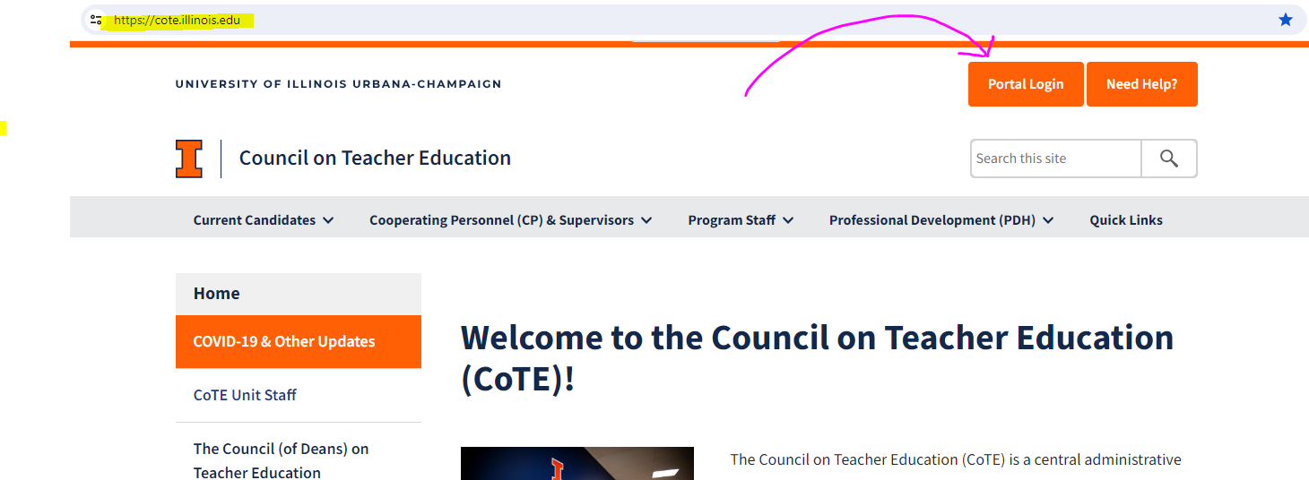
Applying for license through CoTE Portal Don’t procrastinate on this – it will take about 5 minutes to complete!!
Log into your student portal
Log in using your netID (first part of your UIUC email address) only. Do not include the @illinois.edu Example: my UIUC email address is SuzanneL@illinois.edu. I would log in to student portal by entering SuzanneL and then my UIUC active directory/email password

Slide 9
Applying for licensure: After logging in to CoTE student portal
Scroll to “Prior to Licensure: section
Under “Licensure Application” click on the “here” in “Click here to apply”
You will be asked if you are registered for or have previously done student teaching/internship
Presuming you are in your second semester of EPOL 597, answer “yes” and then submit
Click on “Click here to add an application for licensure”

Slide 10
On the CoTE licensure application form:
Email address: Use your most often used, most reliable email address. Do NOT use your UIUC address
Cell phone number
Degree period (should correlate with the term in which you are finishing your internship)
Major (should fill in automatically) Select it.
License (should fill in automatically ) Select it.
Comments: Provide information we can’t see in your transcript (courses to be transferred, additional endorsements you may be seeking [e.g., ESL or bilingual}
Signature (must “sign” stating you understand by checking the box)
Make sure you click “save” before moving on.
Hit submit
Once you submit, you can’t go back. Contact the Council (info@cote.illinios.edu ) if you need to modify/correct/add something. Don’t create a duplicate application.

Slide 11
Before you can be endorsed:
ISBE requires transcripts that document:
Completion of all required supt endorsement courses
Master’s degree or higher
You must send your UIUC transcripts to ISBE!!
Do this anytime during the semester you are completing your final semester of internship
See the UIUC registrar’s site for instructions.
Specifically request that they be sent AFTER the current semester grades are posted.
Send transcripts to the Educator Licensure Division at the Illinois State Board of Education.
You can request that they be sent by paper or electronically (we don’t care which)
Forward the order confirmation you receive from Parchment (transcript company) to CoTE office at info@cote.illinois.edu

Slide 12
If you drift away . . .
Administrator Academy: CoTE is not notified when you complete this requirement. We actively look for it only during your final internship semester.
Content test: CoTE receives and posts these scores to your CoTE portal when you are actively enrolled at the university
SO – We are looking for these requirements during your final internship semester. If you do not complete these requirements at that time, you will need to notify CoTE (info@cote.illinois.edu) that you have completed remaining requirements.
Note: ISBE requirements change over time. If you drift away and do not complete all requirements and claim your endorsement at the time you complete your internship, you will be subject to whatever new requirements ISBE has put into place.

Slide 13
Contact Information:
Location: Education Building - 1310 S. 6th Street, Rm 120
Website: www.cote.illinois.edu
Phone: 217-333-2804
Email
general office correspondence – info@cote.illinois.edu
personal/specific issues - Suzanne Lee SuzanneL@illinois.edu

