Slide 1
Connecting Your Applications with Enterprise Data; How Can We Help?
Jared Crowe, AITS
Peter Herrig, AITS
Jeff Heckel, AITS

Slide 2
28
245
204
>6M/mo
Partners
Apps
Objects
Transactions

Slide 3
Who we are
https://www.aits.uillinois.edu/about_aits
Integration Competency Center (ICC)
Application Development Support and Data (ADSD)
Internal Application Administration (IAA)

Slide 4
Start here…
iccrequests@uillinois.edu

Slide 5
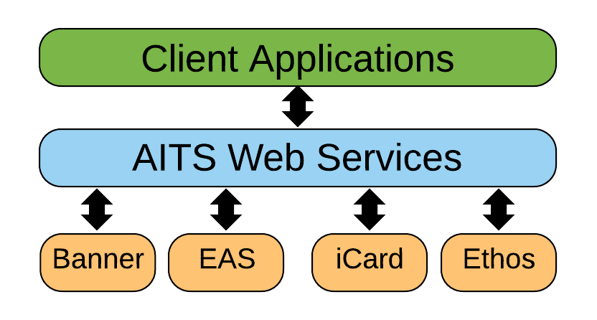
Integration Use Cases – P2P
Point-to-point (synchronous; ‘real time’; web services)
RESTful web services; JSON based; E.g. GET Building

Slide 6
P2P Integrations in Practice
Student data in the university portals
FormBuilder facilitation
Admissions decision loading
New Hire onboarding
Blackboard (UIS)
Vacation and Sick Leave

Slide 7
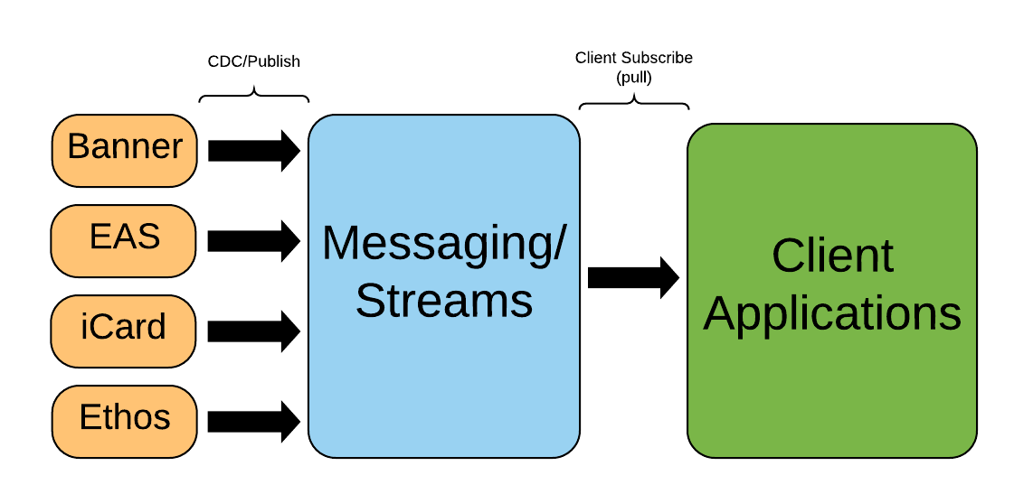
Integration Use Cases - PubSub
Event Driven

Slide 8
PubSub Integrations in Practice
Identity Management
Banner Events
Vendor (Capital Programs) Events

Slide 9
Where we are headed
Bring the enterprise integration platform current with the latest technologies (e.g. Swagger/OpenAPI)
Provide RESTful API alternatives for all legacy integrations. Phase out SOAP-based APIs.
Modernizing event stream (pub-sub) architecture with Kafka as a replacement for JMS.
Removes limitations associated with legacy JMS integrations.
Oracle GoldenGate: Improves timeliness of event streams.

Slide 10
Event Streams (Kafka)
https://www.aits.uillinois.edu/cms/one.aspx?portalId=558&pageId=947851
Address
Admissions Application
Admissions Decision
Registration (course add/drop)
Email
Employee
Job
Person
Phone

Slide 11
Governance
AITS Integration Competency Center
Integration platform gatekeepers
AITS Technical Account Managers
Functional process gatekeepers and data stewards
University Stakeholders
Functional process and data owners. E.g. Registrars, Provosts, HR Offices
Integration analysis and development

Slide 12
Resources
Enterprise API Management Site
https://www.aits.uillinois.edu/services/professional_services/enterprise_api_management
Slack – UofI System – Data Integration
https://uillinois-integration.slack.com

Slide 13
How can we help?
For those that currently have integrations with us, are there any ways that we can improve that experience?
For those that have not built integration with us, what type of enterprise integrations would interest you in the future?
Are there any types of enterprise data not currently available for real time integration that you would like to see made available?
How do you like to collaborate?
How do you like to test (e.g. PostMan, SoapUI, other)?

Slide 14
Thank You

